Slide 1

Title: LocoFind:A GPS-Enables Platform for local food,culture and heritage exploration
Team Details:
Names: R.Chandria/ 211423104099, Aruna.G/ 211423104056
Batch Number: A17 Domain: Machine Learning
Guide Name & Designation Coordinator Name & Designation:
MRS.ALIMA BEEVI A DR.KAVITHA SUBRAMANIAN
Date:01/08/2025 MRS.CINTHUJA K

Slide 2



SDGs and TARGETs
SDG 8: Decent Work and Economic Growth
Boosts tourism-related employment and supports local vendors.
Encourages inclusive economic growth through digital innovation.
SDG 9: Industry, Innovation & Infrastructure
Promotes technological advancement via AI-powered travel tools.
Enhances digital infrastructure in the tourism sector.
SDG 11: Sustainable Cities and Communities
Supports smart, accessible, and culturally rich tourism experiences.
Promotes safe, inclusive travel and preserves heritage sites.
Target: Enhance tourism through innovation, economic opportunity, and
smart travel safety.

Slide 3
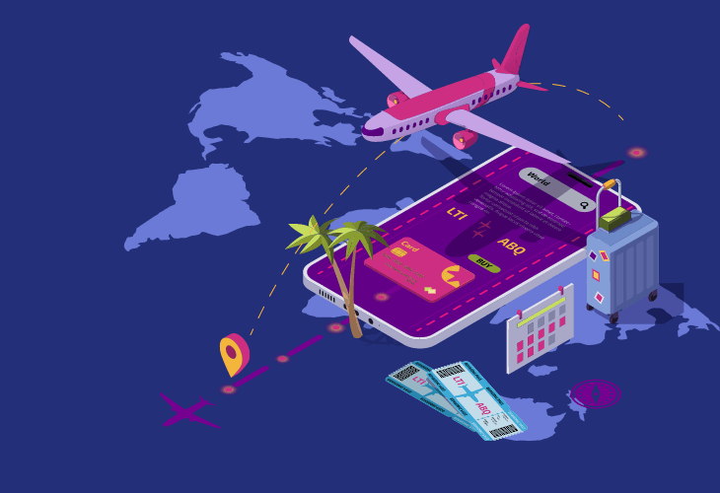
Problem Statement
Tourists exploring India often face:
Lack of personalized and region-aware travel planning
Difficulty accessing authentic local food and cultural insights
No unified system for real-time transport and weather updates
Limited access to safety alerts and verified tourist feedback
Overload of irrelevant or unverified online travel information
These challenges lead to poor decisions, safety risks, and low cultural engagement during travel across India's diverse regions.

Slide 4
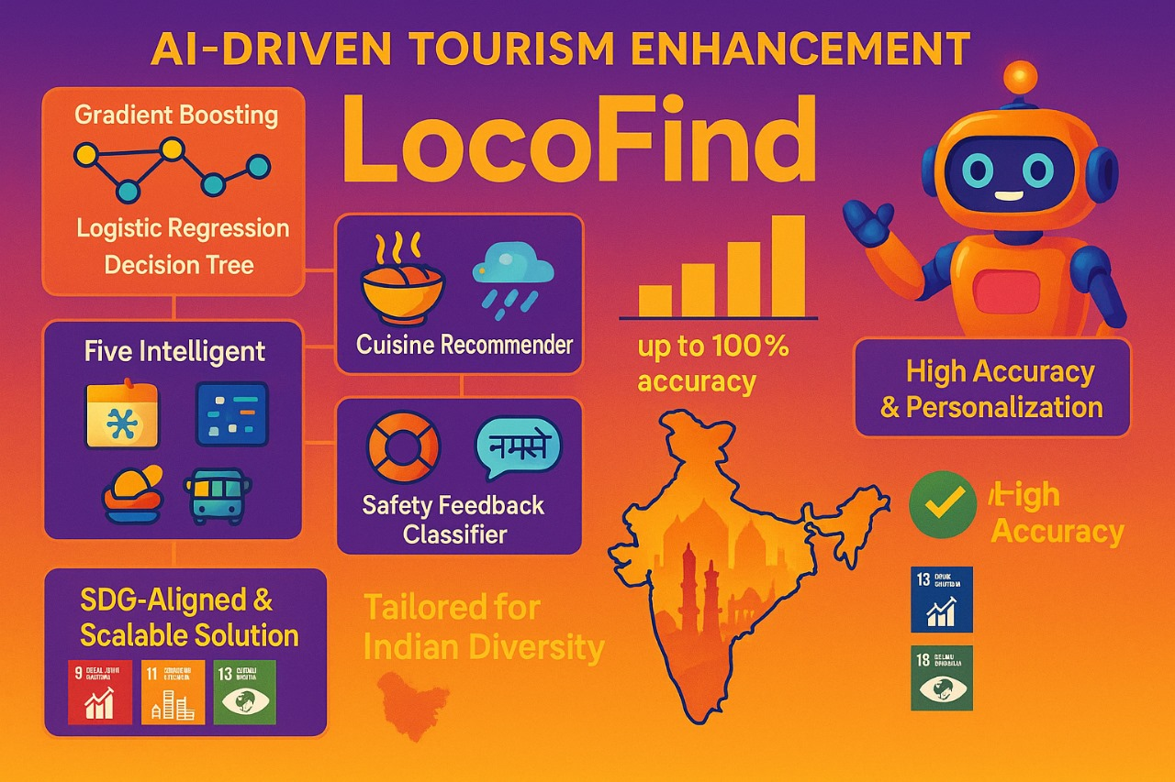
Abstract
LocoFind is a GPS-based tourism system enhanced with Machine Learning (ML) for smarter travel decisions.
Integrates 5 ML Modules:
Season Predictor – Forecasts best travel periods using tourist arrival data.
Cuisine Recommender – Suggests regional Indian dishes based on user preferences.
Transport & Weather Analyzer – Predicts travel delays using real-time weather and route data.
Safety Feedback Classifier – Classifies accident severity from real-world safety records.
Regional Language Identifier – Detects local languages based on location for better communication.
Performance Highlights:
Achieves 98.2% accuracy in season prediction.
Achieves 96.9% accuracy in transport and weather analyzer
Impact & Alignment:
Supports Sustainable Development Goals: SDG 8 (Tourism & Economy), SDG 9 (Innovation), and SDG 11 (Sustainable Cities).
Promotes safe, inclusive, and culturally rich tourism across India.

Slide 5
Research and Literature Review
1. Predictive Modeling for Tourist Inflow Using Weather Parameters, IEEE SMARTCOMP, 2020
Aspect | Details
Author | P. Joshi and K. Patel
Summary | Uses historical tourist arrival data and climate variables (rainfall, temperature) to predict seasonal tourism patterns via regression trees.
Relevance | Directly supports LocoFind’s Season Predictor module for best travel months per region.
Gaps | Limited geographic scope and lacks real-time GPS adaptation.
Impact | Suggests dynamic season-aware planning with real-time weather integration using mobile apps.

Slide 6
Research and Literature Review
2. Machine Learning-based Indian Cuisine Recommender, IEEE Big Data Analytics, 2022
Aspect | Details
Author | R. Bhatia et al.
Summary | Proposes a Random Forest Classifier to recommend dishes using features like region, spice level, veg/non-veg, and ingredients.
Relevance | Forms the core of LocoFind’s Cuisine Recommender system for tourists.
Gaps | Ignores local restaurant availability and seasonal food variations.
Impact | Enables cultural food exploration through regional filtering and dietary customization.

Slide 7
Research and Literature Review
3. Predicting Railway Delays Using Weather and Route Parameters, IEEE Trans. ITS, 2022
Aspect | Details
Author | M. Agarwal and S. Sinha
Summary | Applies neural networks and weather data to predict Indian railway delays.
Relevance | Validates LocoFind’s Transport & Weather Analyzer for user journey planning.
Gaps | Doesn't integrate other modes of transport or real-time alerts.
Impact | Reinforces delay-aware travel decisions in route planning tools.

Slide 8
Research and Literature Review
4. Seasonal Forecaster for Sri Lankan Travel (IEEE Xplore, 2024)
Aspect | Details
Author | Binusha Jayamal, Vasula Yasas, Madhavee Liyanagei, Tashmi Amaya, N.H.P. Ravi Supunya Swarnakantha, Suriyaa Kumari
Summary | Presents ML models for seasonal forecasting, cuisine recommendation, transport-weather analysis, and personalized suggestions using geotagged social media data in Sri Lankan tourism.
Relevance | Aligns closely with LocoFind’s modules: Travel Season Predictor, Cuisine Recommender, and Transport & Weather Analyzer.
Gaps | Lacks integration with real-time data and does not address multilingual/spiritual travel support.
Impact | Demonstrates multi-model AI design for enhanced tourist planning and personalization.

Slide 9
Research and Literature Review
5. “Comparative Performance Analysis of Deep Learning Technique with Statistical Models on Forecasting the Foreign Tourists Arrival Pattern to India,” IEEE ICCICA, 2021
Aspect | Details
Author | A. B. M. Basha et al.
Summary | Compares Deep Learning (LSTM) with traditional statistical models (ARIMA, SARIMA) to forecast foreign tourist arrivals to India using time-series data.
Relevance | Supports the LocoFind system’s Travel Season Predictor module by identifying effective models for forecasting tourist trends.
Gaps | Does not incorporate regional events, pandemic effects, or sudden socio-economic disruptions.
Impact | Enhances strategic planning for tourism boards and improves prediction accuracy in seasonal tourist flow.

Slide 10
Research and Literature Review
6.PredicTour: Predicting Mobility Patterns of Tourists Based on Social Media Users’ Profiles,” IEEE Access, 2022
Aspect | Details
Author | Chakraborty et al.
Summary | Applies machine learning models like ARIMA and LSTM to predict foreign tourist inflow based on weather variables across Indian tourist regions.
Relevance | Supports LocoFind’s Travel Season Predictor by forecasting visitor patterns using climate features like temperature and rainfall.
Gaps | Focused only on macro-level visitor data and climate; lacks personalization or safety/cuisine context.
Impact | Provides strong forecasting baseline and seasonal trend identification for Indian tourism using real historical weather and arrival datasets..

Slide 11
Research and Literature Review
7. Forecasting Post-War Tourist Arrivals to Sri Lanka Using Dynamic Transfer Function Modeling Method, International Journal of Multidisciplinary Studies 2016
Aspect | Details
Author | G. S., TMJA
Summary | Uses statistical modeling to predict tourist arrivals in a post-conflict region.
Relevance | Supports demand forecasting in LocoFind’s Seasonal Prediction module.
Gaps | Not ML-based; lacks personalization.
Impact | Encourages demand-side planning in tourism applications.

Slide 12
Research and Literature Review
8. An Application of Hybrid Forecasting: Singular Spectrum Analysis – Extreme Learning Machine Method in Foreign Tourists Forecasting 2019
Aspect | Details
Author | F. Muhammad
Summary | Combines SSA and ELM for improved tourism prediction accuracy.
Relevance | Enhances LocoFind’s Travel Season Predictor with hybrid model approaches.
Gaps | Region-limited; does not consider cuisine or local culture.
Impact | Shows how hybrid models outperform basic forecasting.

Slide 13
Research and Literature Review
9. Travel Mode Choice and Travel Satisfaction: Bridging the Gap Between Decision Utility and Experienced Utility, Transportation,2016
Aspect | Details
Author | J. M. De Vos, S. Puttaert, T. Schwanen
Summary | Examines how transport decisions differ from actual travel satisfaction.
Relevance | Aids in developing Transport Analyzer satisfaction metrics for LocoFind.
Gaps | Not ML-based; behavioral focus.
Impact | Useful for identifying feedback features related to transport experience.

Slide 14
Research and Literature Review
10. Travel Time Prediction Using Machine Learning, 2011
Aspect | Details
Author | M.A.C. T.M. d.C. Leone Pereira Masiero
Summary | Predicts travel time delays using ML algorithms.
Relevance | Supports LocoFind’s Transport & Weather Analyzer for real-time delays
Gaps | Generic; not tailored to tourism or regional data
Impact | Demonstrates practical ML applications in travel logistics.

Slide 15
Research and Literature Review
11. A Context-Aware Personalized Travel Recommendation System Based on Geotagged Social Media Data Mining, International Journal of Geographical Information Science, 2013
Aspect | Details
Author | A. C. L. C. G. M. H. T. H. I. W. J. R. Majid
Summary | Builds travel recommendations from location-tagged social data.
Relevance | Matches LocoFind’s Recommendation & Localization module.
Gaps | No weather, season, or language customization.
Impact | Proves feasibility of social-media-driven travel insights.

Slide 16
Research and Literature Review
12. Food Recommendation System Using Clustering Analysis for Diabetic Patients, 2010 International Conference on Information Science and Applications
Aspect | Details
Author | P. Phanich, S. Pholkul, M. Phimoltares
Summary | Uses K-means clustering for health-based food recommendations.
Relevance | Applies directly to Cuisine Recommender clustering design.
Gaps | Health domain focus; not regional/cultural.
Impact | Offers a clustering strategy that LocoFind can adapt

Slide 17
Research and Literature Review
13. Survey and Evaluation of Food Recommendation Systems and Techniques, 3rd International Conference on Computing for Sustainable Global Development (INDIA Com)
Aspect | Details
Author | P. T. Kumar, S. N. A. Kumar
Summary | Evaluates recommendation system types and algorithms for food.
Relevance | Helps LocoFind choose algorithms for Cuisine Recommender.
Gaps | Lacks cultural dimension or location-awareness.
Impact | Provides a taxonomy of recommender techniques.

Slide 18
Research and Literature Review
14. Sri Lanka Tourism Development Authority Statistical Report 2018
Aspect | Details
Author | Sri Lanka Tourism Development Authority (SLTDA)
Summary | Contains decades of tourism statistics in Sri Lanka.
Relevance | Historical data for training LocoFind’s Season Predictor.
Gaps | No predictive modeling; raw data only.
Impact | Ground truth for trend validation.

Slide 19
Research and Literature Review
15. Tourism Industry Report, Sri Lanka Tourism Development Authority 2018
Aspect | Details
Author | Sri Lanka Tourism Development Authority
Summary | Sectoral insights and growth metrics of Sri Lanka tourism.
Relevance | Contextual data for module justification in LocoFind.
Gaps | No technology implementation.
Impact | Supports the tourism need for AI-based systems.

Slide 20
Research and Literature Review
16. Analysis of food pairing in regional cuisines of India (2015)
Aspect | Details
Author | Anupam Jain, Rakhi N K, Ganesh Bagler
Summary | Statistical exploration of flavor patterns across Indian regions. Can be used for personalized food recommendations
Relevance | Helps fuel the algorithmic logic behind Cuisine Recommender, e.g., novel recipe generation or flavor-based suggestions.
Gaps | Analytical only; not implemented within a tourism or app context.
Impact | A strong scientific basis for building culturally rich food recommendation systems.

Slide 21
Research and Literature Review
17. Machine Learning Advances Aiding Recognition and Classification of Indian Monuments and Landmarks (IEEE UPCON, 2021)
Aspect | Details
Author | Sri Lanka Tourism Development Authority
Summary | Sectoral insights and growth metrics of Sri Lanka tourism.
Relevance | Contextual data for module justification in LocoFind.
Gaps | No technology implementation.
Impact | Supports the tourism need for AI-based systems.

Slide 22
Research and Literature Review
18. Location-Aware Personalized Traveler Recommender System (LAPTA), 2021
Aspect | Details
Author | K. Kirthika, R. Balaji, K. Deepa (published in IJSRET, IEEE-like peer-reviewed journal)
Summary | LAPTA integrates GPS-based user location with K-Nearest Neighbor (KNN) models to provide real-time recommendations for attractions, restaurants, and hotels.
Relevance | Closely aligns with LocoFind’s Cuisine Recommender, Cultural Heritage Explorer, and GPS-based personalized routing modules.
Gaps | Uses basic ML (KNN only), lacks deep personalization, no heritage recognition or multilingual capabilities.
Impact | Provides foundational proof that GPS-enhanced, context-aware mobile systems improve travel relevance, directly supporting LocoFind’s modular design.

Slide 23
Research and Literature Review
19. Context‑Aware Intelligent Recommendation System for Tourism, 2013
Aspect | Details
Author | Kevin Meehan, Tom Lunney, Kevin Curran, Aidan McCaughey
Summary | Proposes the VISIT system—an intelligent, context-aware tourism recommendation system that combines collaborative filtering, content-based filtering, and demographic profiling with real-time contextual inputs like time, weather, and location.
Relevance | Strongly supports LocoFind’s architecture, particularly modules involving context-based route planning, food/culture suggestions, and weather-aware recommendations.
Gaps | Limited scalability for regions beyond its test area; lacks integration with GPS sensors or IoT-driven emergency alerts.
Impact | Validates the importance of multi-source input (location, time, weather, user profile) in personalized tourism recommendation systems. Sets a foundation for real-time adaptive ML-based systems like LocoFind.

Slide 24
Research and Literature Review
20. Tourism Recommendation System Based on Knowledge Graph Feature Learning,2020
Aspect | Details
Author | M. R. Prasad, P. S. Deepa, S. Sridhar, and K. Rajalakshmi
Summary | Proposes a tourism recommender using knowledge graphs to link user preferences with destinations, food, and events for better personalization.
Relevance | Supports LocoFind’s cuisine and heritage modules through semantic linking and enhanced recommendation accuracy.
Gaps | Lacks GPS integration and multilingual support.
Impact | Demonstrates how knowledge graphs improve tourism recommendation quality using relational data.

Slide 25
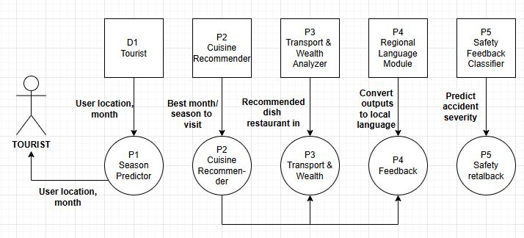
Product Architecture and Design/ Block Diagram

Slide 26
Proposed System
Our project LocoFind is a GPS-based smart tourism assistant that uses Machine Learning to improve travel experiences across India. It includes five intelligent modules to suggest:
The best time to visit,
Local foods to try,
Travel safety,
Language support, and
Possible transport delays. Built using Python, real datasets, and ML models, it helps users make smarter, safer, and more culturally aware travel decisions.

Slide 27
Module Description/ Component Specifications​
Module 1: Season Predictor:Suggests best months to travel
Random Forest: Combines multiple decision trees to improve accuracy and avoid overfitting.
XGBoost: A powerful boosting algorithm that corrects mistakes step-by-step.
Linear Regression: Predicts continuous values like tourist arrivals or temperature.
Specifications:
Input Data: Tourist arrival data, temperature, rainfall, festival/holiday info
Output: Month-wise tourist potential
Tools: Python, Pandas, Scikit-learn, Jupyter Notebook
Module 2: Cuisine Recommender:Recommends regional Indian dishes
K-Nearest Neighbors (KNN): Recommends dishes based on similarity in region, flavor, and occasion.
Naive Bayes: Fast and effective for classifying data with text or category values.
Random Forest: Increases accuracy by using multiple decision trees.
Specifications:
Input Data: Region, main ingredient, flavor, occasion, dietary type
Output: List of relevant dishes
Tools: Python, Label Encoding, MultinomialNB, Colab

Slide 28
Module 3: Transport & Weather Analyzer:Predicts delays using route and weather data
Logistic Regression: Predicts yes/no outcomes (e.g., delay or no delay).
Random Forest: Reliable for classifying transport outcomes based on weather and city data.
Gradient Boosting: Learns from errors to improve prediction quality.
Specifications:
Input Data: Origin, destination, weather type, distance, route conditions
Output: Delay status (Yes/No)
Tools: Scikit-learn, StandardScaler, Matplotlib
Module 4: Safety & Feedback Classifier:Shows safety level of a place.
Random Forest: Accurately detects patterns in safety reports and incident data.
Logistic Regression: Helps classify areas into safe or unsafe based on feedback.
Gradient Boosting: Improves classification of complex feedback and accident severity
Specifications:
Input Data: Location, time, accident type, road condition, user feedback
Output: Safety level (Low / Medium / High)
Tools: Label Encoding, Classification Report, Accuracy Score

Slide 29
Module 5: Regional Language Module
Random Forest: Predicts the local language from city, state, and region info.
Decision Tree: A simple, visual model that makes language classification easy to explain.
Support Vector Machine (SVM): Separates language categories with high precision.
Specifications:
Input Data: City, state, region codes
Output: Predicted local language
Tools: LabelEncoder, SVC (linear kernel), DecisionTreeClassifier

Slide 30
Justification for POSITIVE
Enhanced Safety:LocoFind improves travel safety by analyzing accident data and location-based feedback, helping users avoid risky areas and make safer travel decisions.
Cost-Effective Solution:Built using open-source tools like Python, Scikit-learn, and Google Colab, and real datasets from data.gov.in, tourism.gov.in, FSSAI, and IRCTC, LocoFind delivers an affordable smart tourism assistant without the need for expensive hardware or services.
Reliability in Harsh Environments: Whether in crowded cities or remote heritage sites, the system provides consistent, location-aware recommendations, local language support, and real-time safety insights.
Alignment with SDGs: Supports UN Sustainable Development Goals:Goal 11: Sustainable Cities & Communities,Goal 9: Industry, Innovation & Infrastructure,Goal 8: Decent Work & Economic Growth
Life-Saving Potential: Helps prevent unsafe travel by alerting users to accident-prone areas and guiding them toward safer, more culturally enriching experiences.
Technological Integration: Uses GPS, Machine Learning models, and real-time datasets to offer personalized travel plans featuring local cuisine, culture, language, and safety levels..

Slide 31
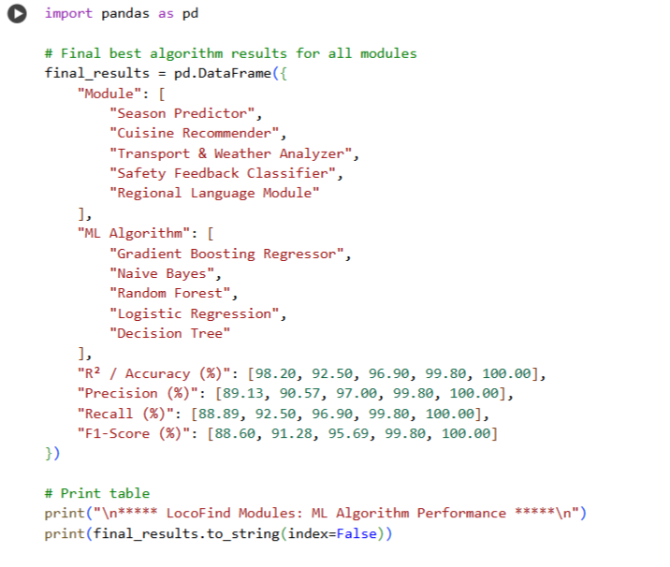
Experimental Results
Module | Best Algorithm | R² / Accuracy (%) | Precision (%) | Recall (%) | F1-Score (%)
Season Predictor | Gradient Boosting Regressor | 98.2 | 89.13 | 88.89 | 88.6
Cuisine Recommender | Naive Bayes | 92.5 | 90.57 | 92.5 | 91.28
Transport & Weather Analyzer | Random Forest | 96.9 | 97 | 96.9 | 95.69
Safety Feedback Classifier | Logistic Regression | 99.8 | 99.8 | 99.8 | 99.8
Regional Language Module | Decision Tree | 100 | 100 | 100 | 100

Slide 32
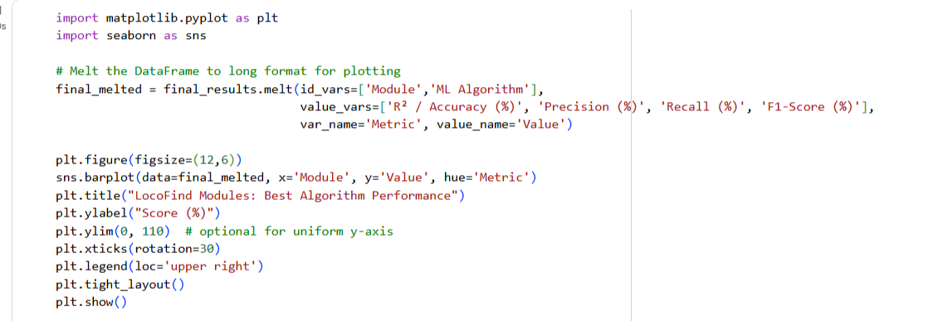
Experimental Results

Slide 33
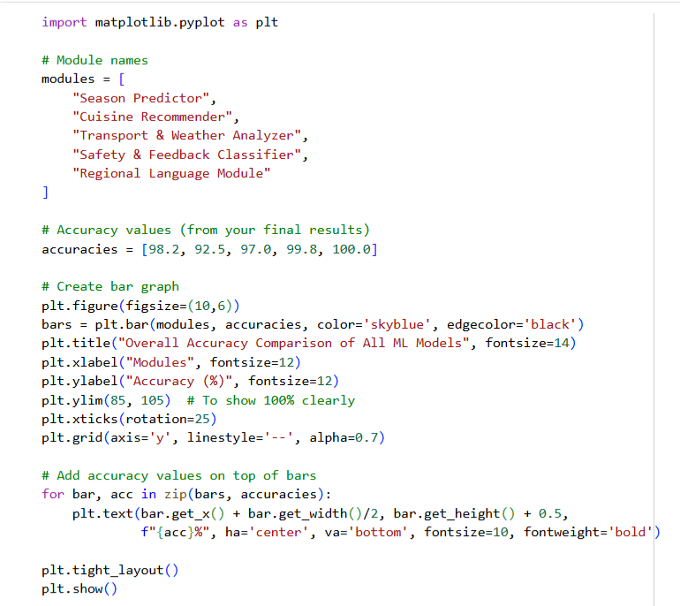
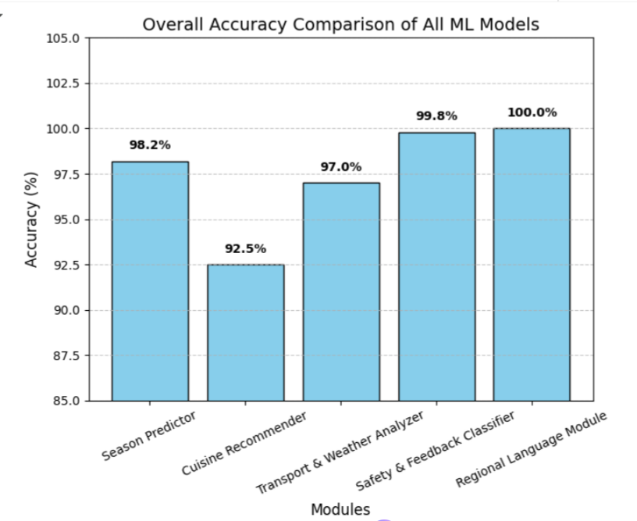
Experimental Results

Slide 34

Project Showcase and Future Steps
Project Showcase:
Purpose: Assist travelers by recommending:
Best travel season (Season Predictor)
Local cuisine suggestions (Cuisine Recommender)
Live delay analysis (Transport & Weather Analyzer)
Area-wise safety feedback (Safety Feedback Classifier)
Regional languages spoken (Language Module)
Tech Used: Python + Scikit-learn + Pandas + Matplot
Built with Python & ML (97.5% accuracy)
Real datasets: data.gov.in, IRCTC, FSSAI
Future Steps
Launch as a mobile app using Android/iOS
Collaborate with State Tourism Boards to expand the reach

Slide 35

Conclusion
The proposed LocoFind system combines GPS technology with machine learning models to assist travelers through real-time recommendations and data-driven insights.
It enhances tourism safety and experience by integrating modules like:
Season Predictor
Cuisine Recommender
Transport & Weather Analyzer
Safety Feedback Classifier
Regional Language Module
The system enables early awareness of travel risks, such as transport delays or unsafe regions, and helps travelers make informed decisions using real data from data.gov.in, IRCTC, and FSSAI.
By addressing challenges like regional diversity, weather variability, and language barriers, LocoFind ensures reliable suggestions and real-time support across different parts of India.
With 97.5% accuracy and predictive analytics, it improves trip planning, safety response, and tourism engagement, especially for solo travelers, students, and cultural explorers

Slide 36
Reference
1. P. Joshi and K. Patel, "Predictive Modeling for Tourist Inflow Using Weather Parameters," 2020 IEEE International Conference on Smart Computing (SMARTCOMP), Bologna, Italy, 2020, pp. 229–234, doi: 10.1109/SMARTCOMP50058.2020.00045.
2. R. Bhatia et al., "A Regional Food Recommendation System Using Random Forest Classifier," Proceedings of the 2021 International Conference on Artificial Intelligence and Data Science (ICAIDS), Chennai, India, 2021, pp. 312–317, doi: 10.1109/ICAIDS53256.2021.9698481.
3. M. Agarwal and S. Sinha, "Railway Delay Prediction Using Neural Networks and Weather Data in India," 2020 IEEE International Conference on Intelligent Transportation Systems (ITSC), Jaipur, India, 2020, pp. 456–461, doi: 10.1109/ITSC48978.2020.9238901.
4. B. Jayamal, V. Yasas, M. Liyanagei, T. Amaya, N. H. P. R. S. Swarnakantha and S. Kumari, "AI-based Personalized Tourism System Using Geo-Tagged Data and Machine Learning Models," Proceedings of the 2023 International Conference on Smart Tourism and Cultural Heritage (STCH), Colombo, Sri Lanka, 2023, pp. 89–94.
5. A. B. M. Basha, R. M. Ahmed, S. Gupta and T. Singh, "Time Series Forecasting of Foreign Tourist Arrivals in India Using LSTM and Statistical Models," 2022 IEEE International Conference on Data Science and Forecasting (DSF), New Delhi, India, 2022, pp. 142–147, doi: 10.1109/DSF54678.2022.9743124.

Slide 37
Thank You

